Slide 1
Thinking About Thinking

Slide 2
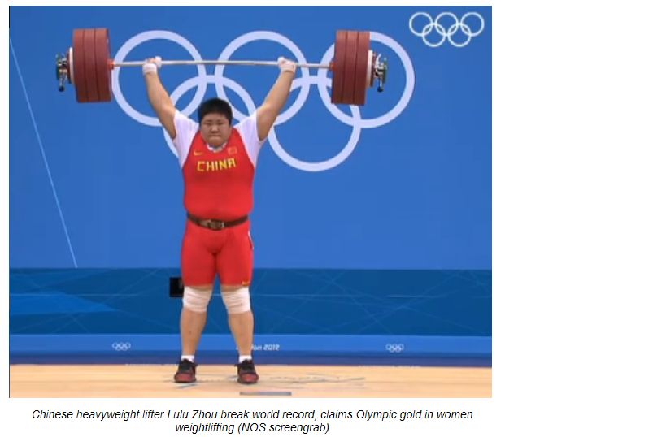

Slide 3
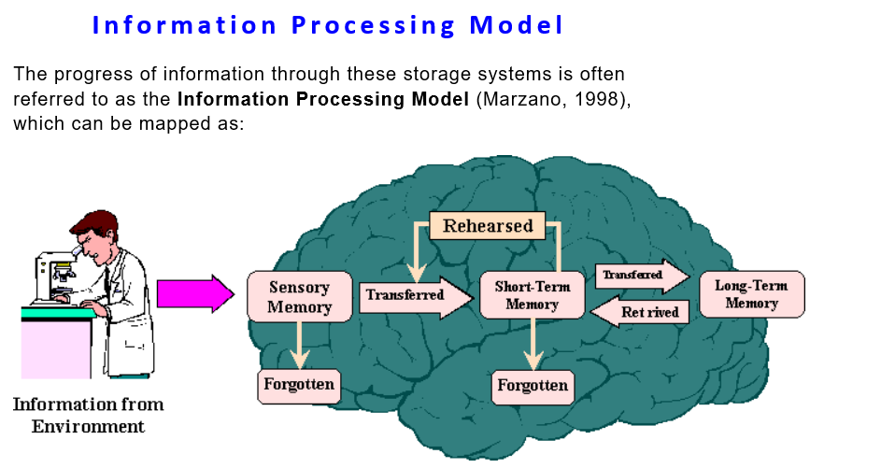

Slide 4


Slide 5


Slide 6


Slide 7


Slide 8
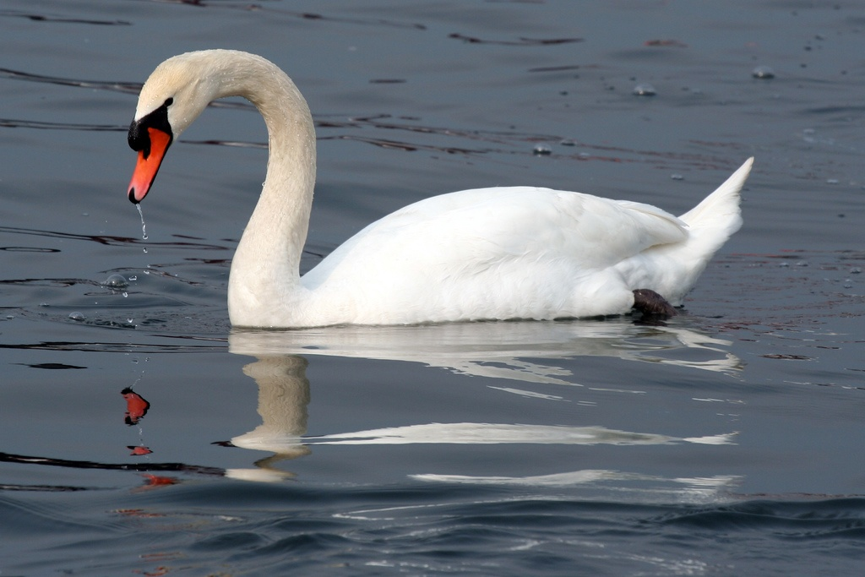

Slide 9


Slide 10
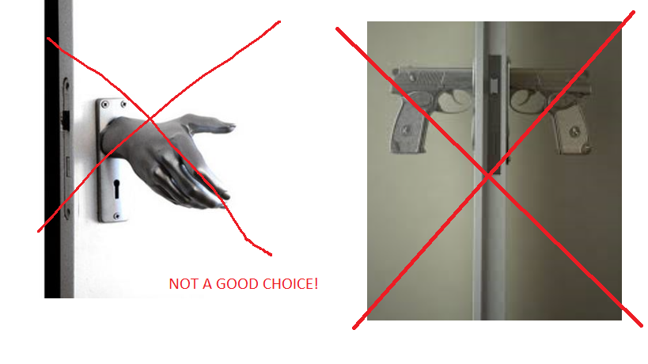

Slide 11
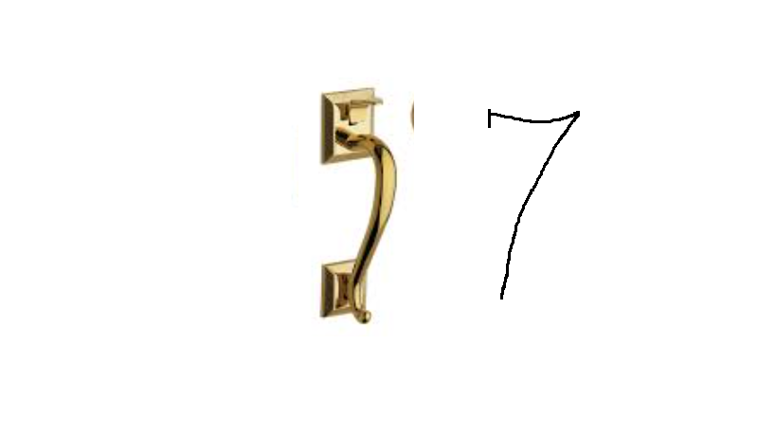

Slide 12


Slide 13

We are abele to memorize much more, just do it right, start training your memory!

